Slide 1

Analyzing the Leading Causes of Death In The US
Contributors
Alicia Perez, Claude Hanfou, Kathy Nguyen

Slide 2
Background
According to data from the National Center for Health Statistics (NCHS), which is overseen by the Center for Disease Control (CDC), one of the leading causes of death in the United States is heart disease.
In this regard, we have developed a web page which provides users with information about which states have the highest age adjusted death rates and used machine learning to create models which predict a user’s cause of death and chances of having heart disease.

Slide 3
Questions to Address
Question 1
Causes of Death
What are the leading causes of death?
Question 2 States
Which states have the highest death rates?
Question 3 Prediction
How would a person die ?
Question 4
Heart
What are the chances of having heart disease?

Slide 4

Data Exploration and Cleanup
Data sources:
Center for Disease Control and Prevention, CDC (Extracted data on the leading causes of death from 1999-2017)
Kaggle (Extracted life expectancy data, Heart Disease statistics uci and Causes of Deaths(Demographic based)
Roadblock:
The causes of death data used for the machine learning contained millions of rows of data and thousands of causes of death which had to be scaled down for effectiveness

Slide 5

Technologies and Design
Pulled the data from csv files using Jupyter notebook and PySpark
The data was loaded into an Amazon Postgres database using Python
A ﬂask app was created to pull data from the Postgres database
A Python file and PySpark were used to create machine learning models
The Flask app was used to load the machine learning models
Tableau Public was used to create various visualizations
Display and design was accomplished using HTML
The webpage was beautified using Bootstrap and css
Heroku was used to deploy the app

Slide 6

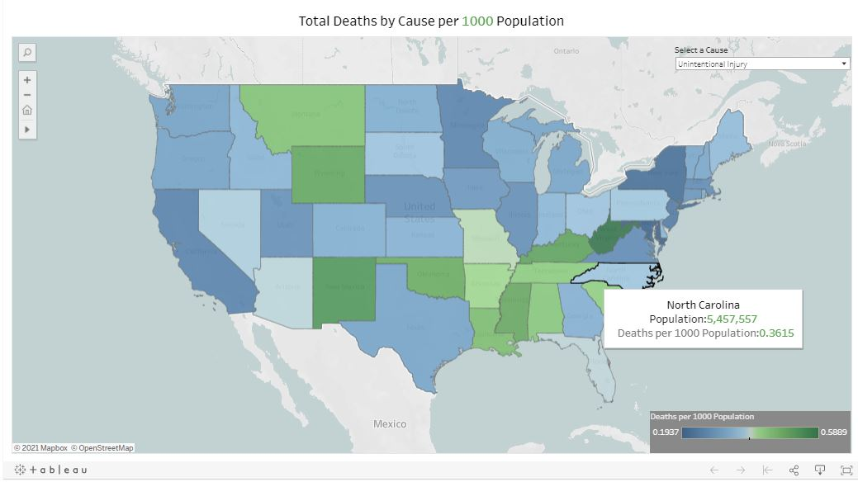
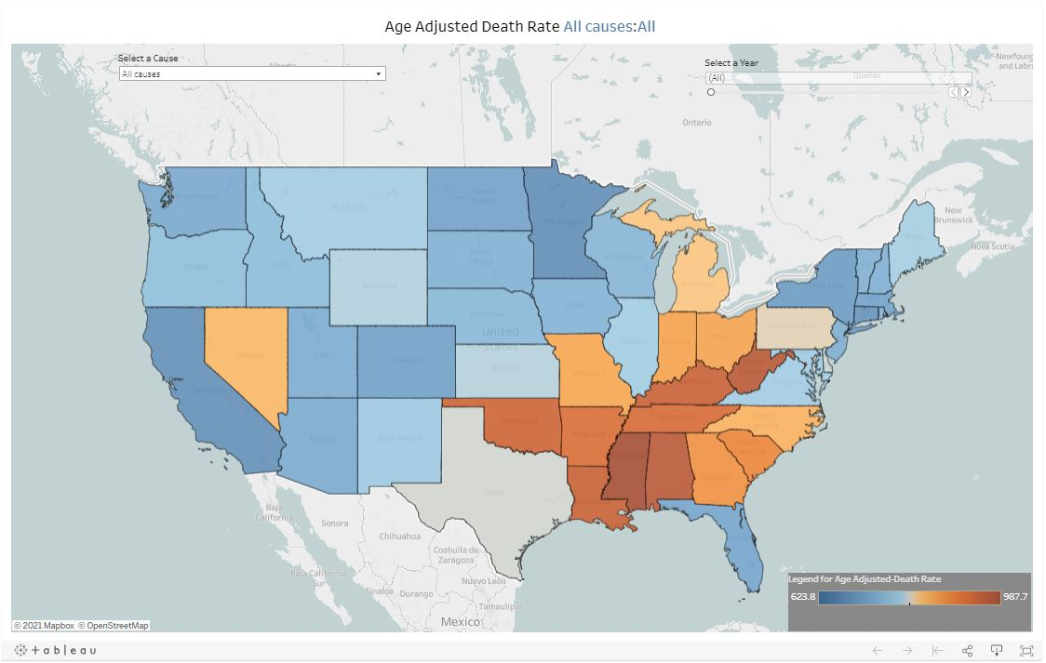
Tableau Visualizations
Total Deaths per 1000 Population
Age Adjusted Death Rates
Minnesota and N.Dakota have lowest the age adjusted death rates
Louisiana, Kentucky, Alabama have the highest heart disease death rates
Wyoming is among the highest with suicide rate on the national level
Wyoming, West-Virginia and New Mexico have the highest death rate with 0.5 death for 1000 people
Minnesota, New York, California have the lowest rate with 0.2 deaths for 1000 people

Slide 7
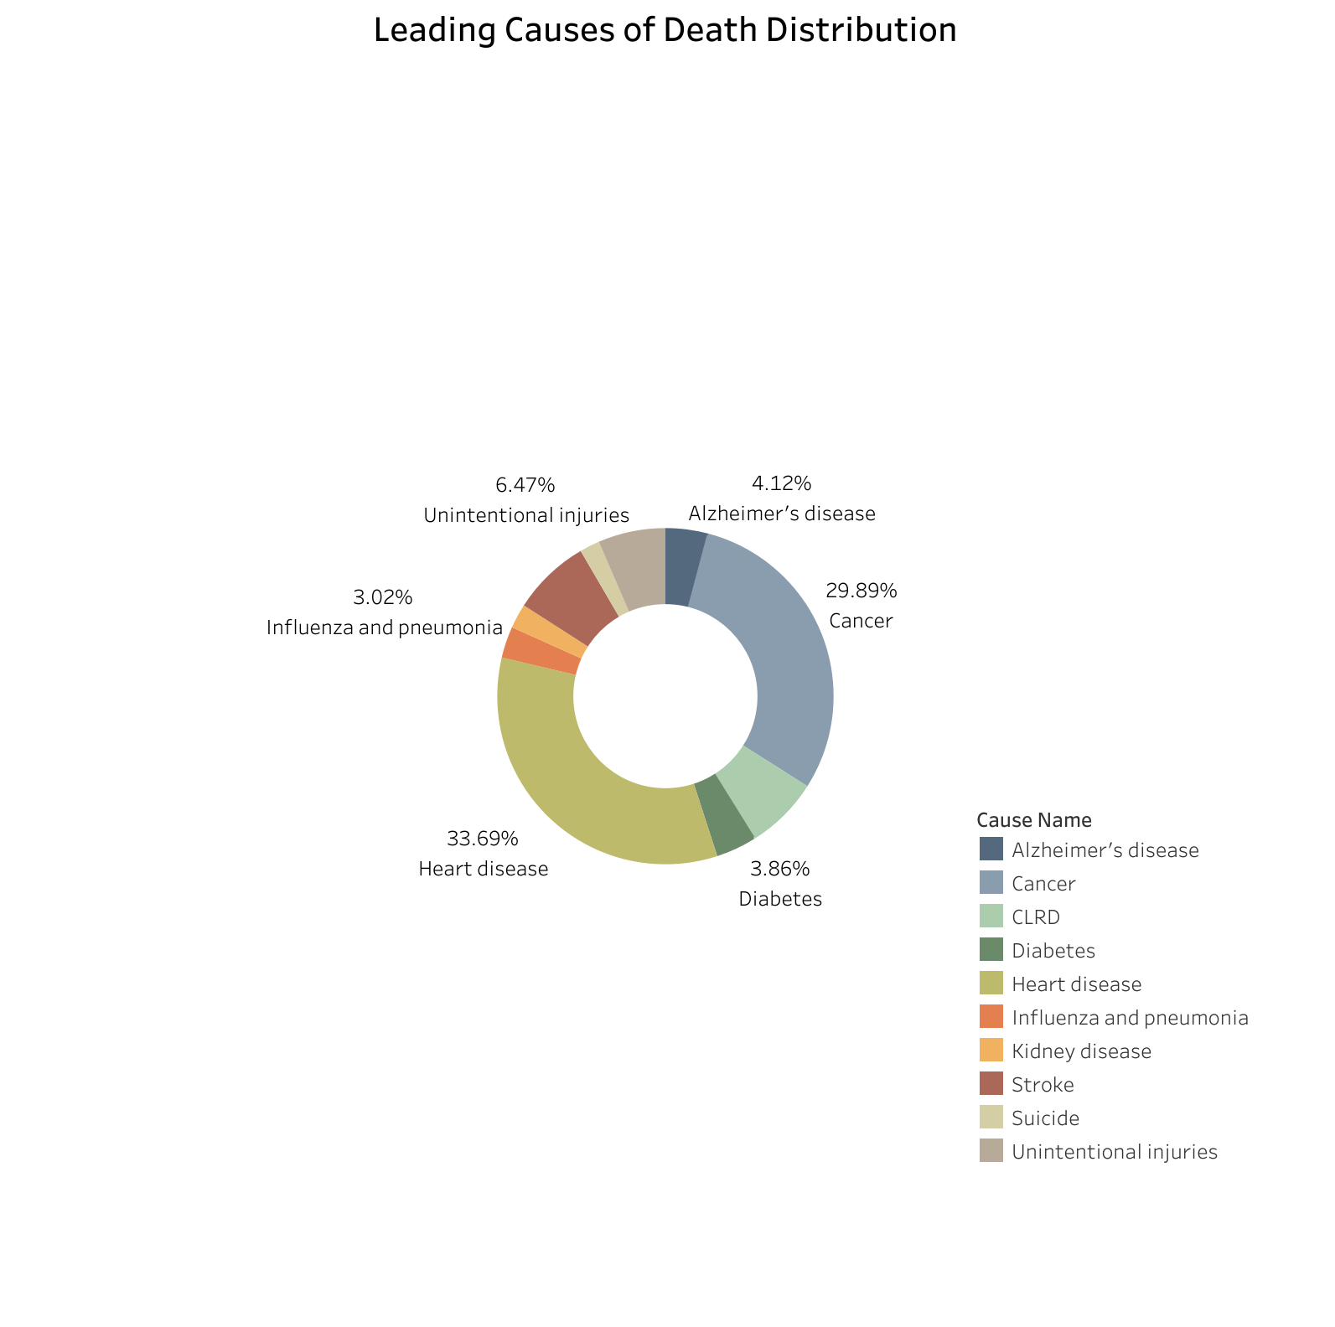
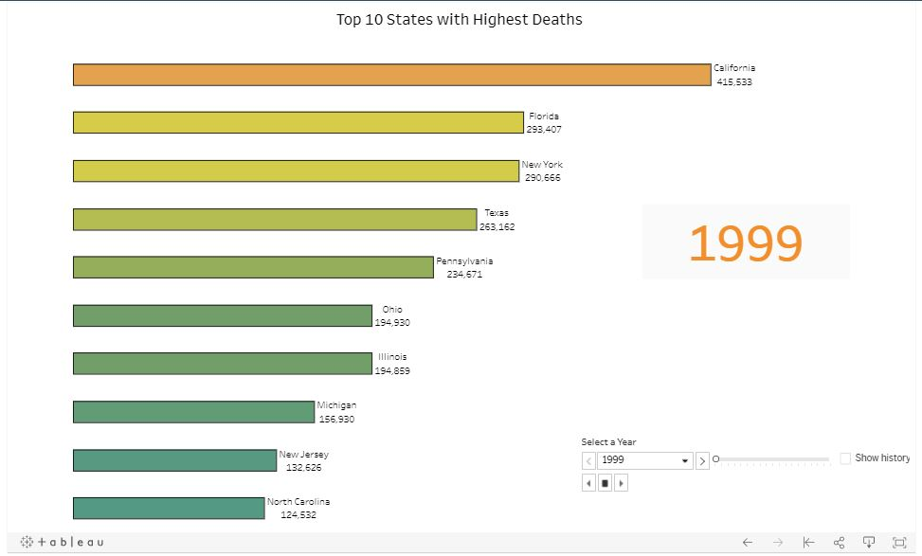
Visualizations II
Causes Distribution
Top 10 States with Highest Deaths
California
Florida
New York
Texas
Heart Disease 33%
Cancer 29%
Stroke 7.5%
Chronic Lower Respiratory Disease (CLRD) 7.15%
Unintentional Injuries 6.47%

Slide 8
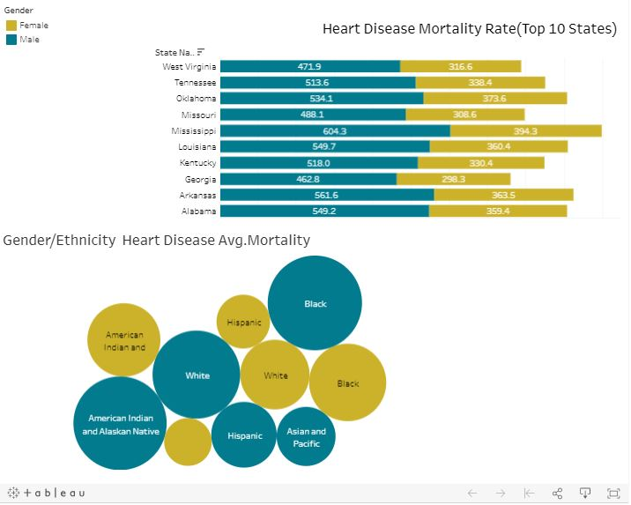
Visualizations III
Heart Disease Mortality Distribution
Highest :Black ,White and American Indian males
Highest: Black and American Indian females
Lowest :Asian and Pacific Islander males
Lowest: Hispanic and Asian and Pacific Islander females

Slide 9

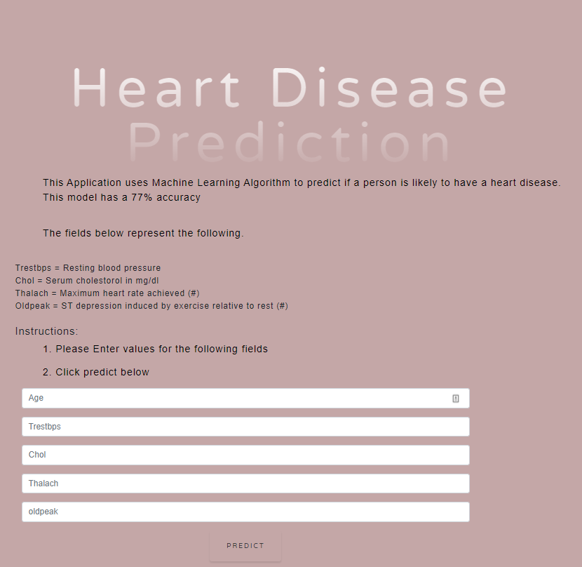
Machine Learning
Heart Disease Prediction
Trestps (Blood pressure at rest i.e. arriving in the hospital)
Cholesterol Level
Thalach (Maximum Heart rate achieved)
Oldpeak

Slide 10

Machine Learning
Death Machine
Education
Gender
Age
Marital Status
Race
Hispanic

Slide 11
Discussion
Conclusions:
There appears to be an increase in the age adjusted death rate
Heart Diseases remains as the top leading cause of death over the observed period
Challenges:
Some deaths may not have been recorded due to the absence of death certificates

Slide 12
Summary
Goal:
The webpage provides a user interface to filter for a specific year and cause of death
The machine learning model predicts causes of deaths and heart disease based on input fields
Future Goals:
App:
The app can be viewed at this link https://death-machine.herokuapp.com/

Slide 13

Questions ?

